Slide 1
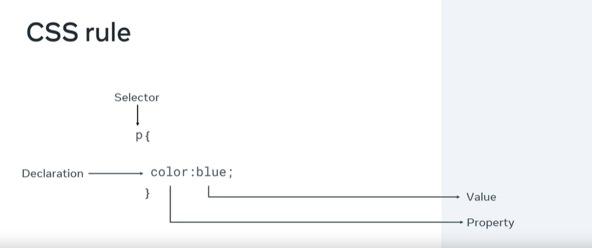
CSS rule
<link rel="stylesheet" href="style.css"/>

Slide 2
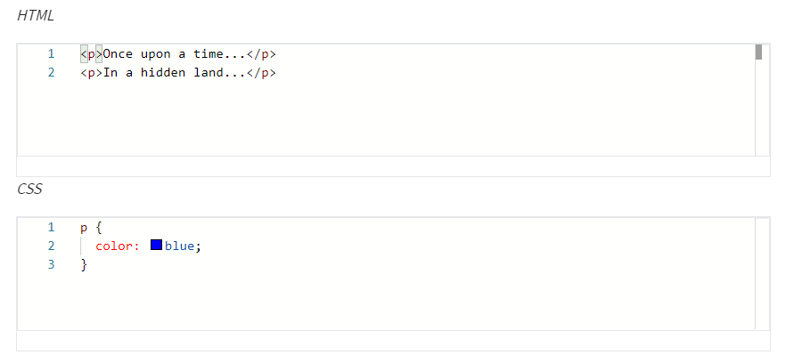
Selectors
Element Selectors

Slide 3
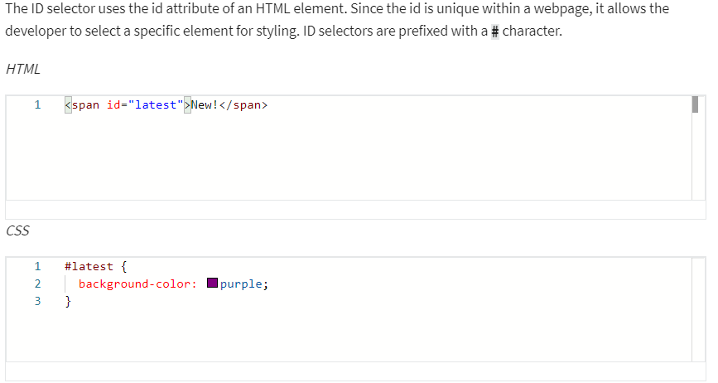
Selectors
ID Selectors

Slide 4
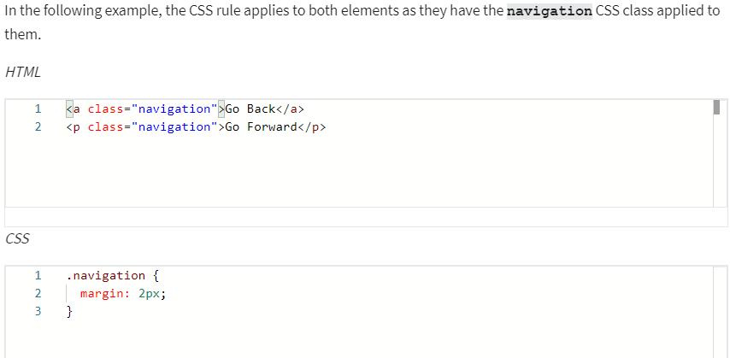
Selectors
Class Selectors

Slide 5
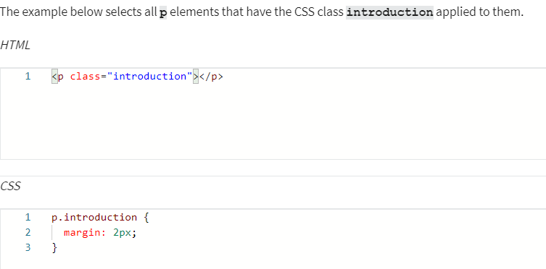
Selectors
Element with Class Selector

Slide 6
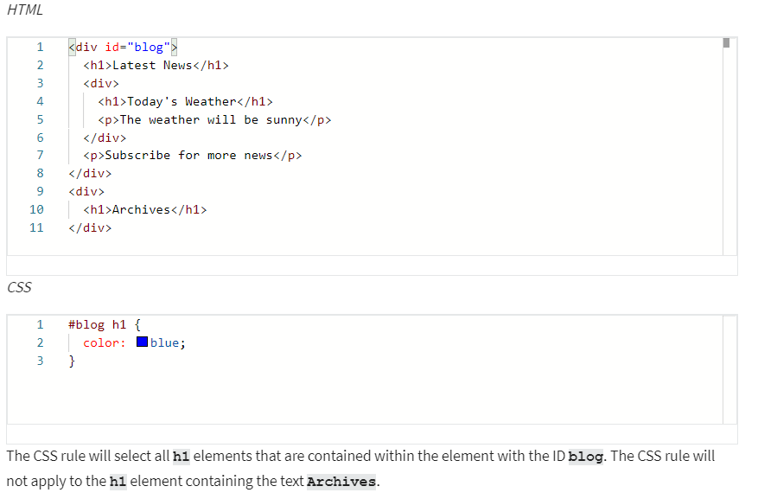
Selectors
Descendant Selectors

Slide 7
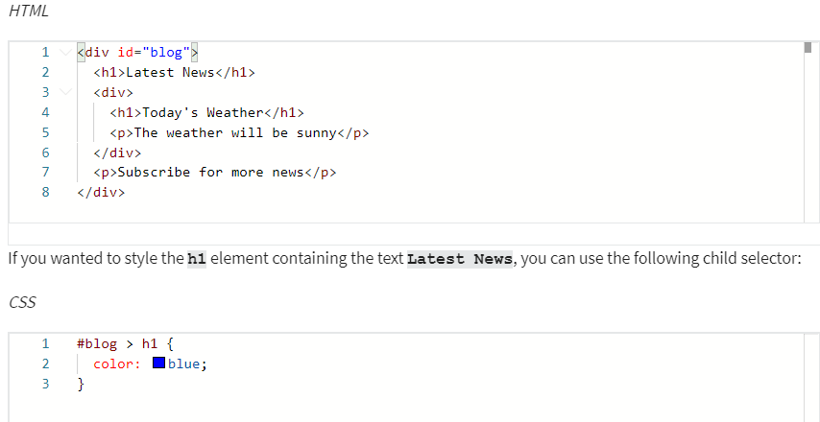
Selectors
Child Selectors
Note that this will not go beyond a single depth level. Therefore, the CSS rule will not be applied to the h1 element containing the text Today's Weather.

Slide 8
Text and color in CSS
color: rgb(255, 0, 0)
color: rgba(255, 0, 0, 0.8);
color: hsl(0, 100%, 50%)
Hex value
Predefined color names
font-family: "Courier New", monospace;
font-size: 12px;
text-transform: uppercase
text-decoration: underline red solid 5px
text-decoration-line: underline;
text-decoration-color: red;
text-decoration-style: solid;
text-decoration-thickness: 5px;
The most commonly used values for the text-transform property are: uppercase, lowercase, capitalize and none.
The most common text-decoration-line values used are: underline, overline, line-through and none.
There are many styles available for the text-decoration-style property; solid, double, dotted, dashed and wavy.

Slide 9
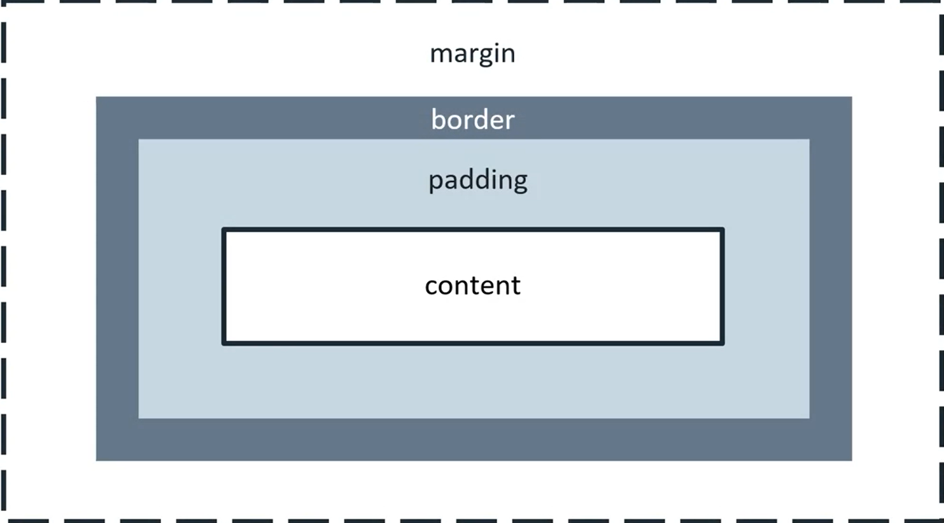
Box

Slide 10
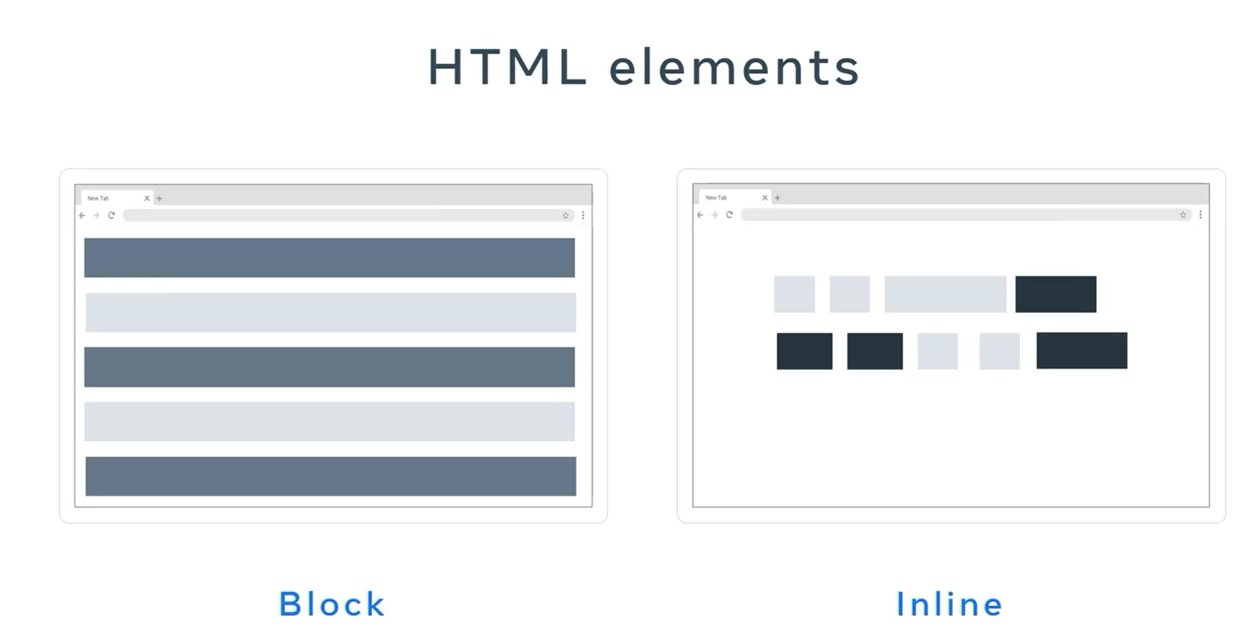
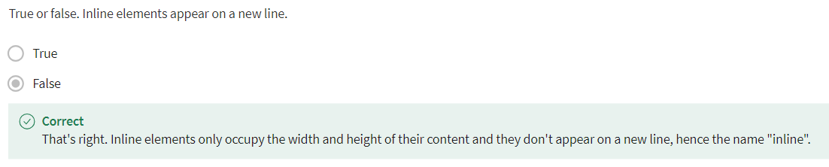

Slide 11
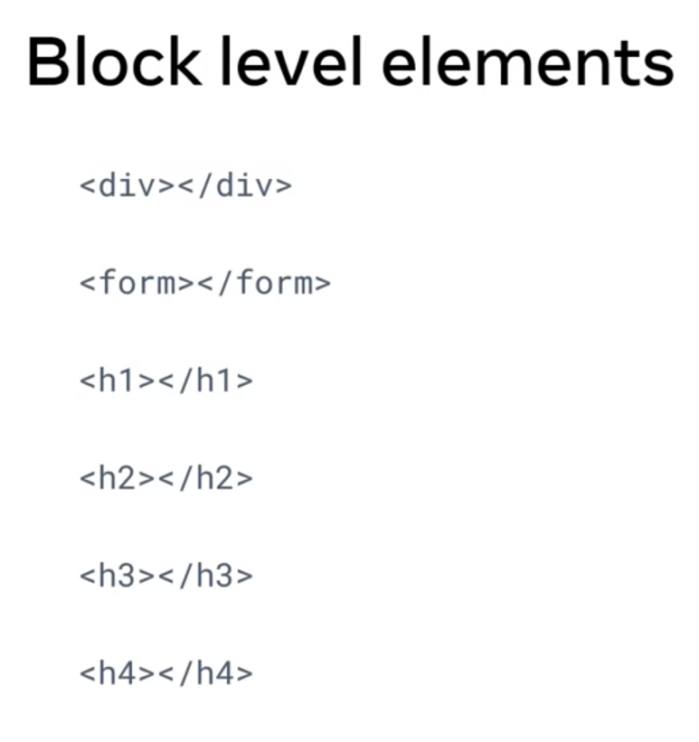
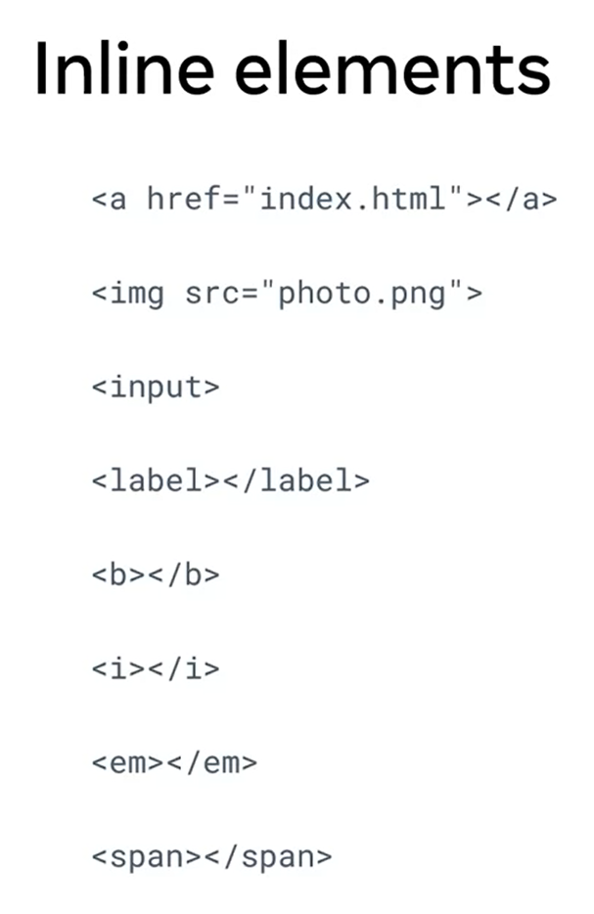
Block level elements and Inline elements

Slide 12
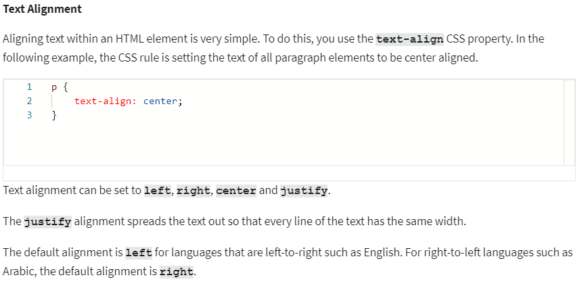
Alignment

Slide 13
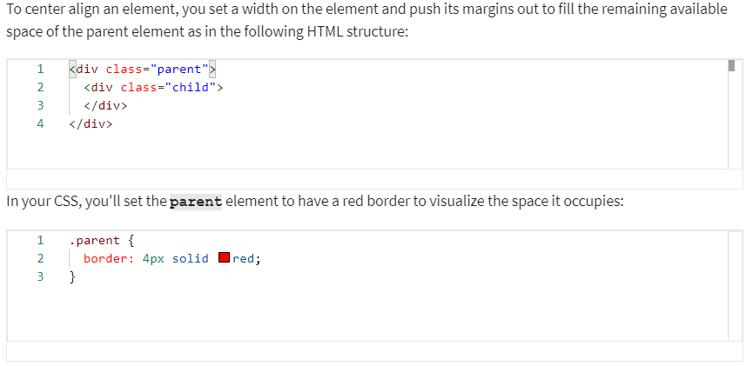
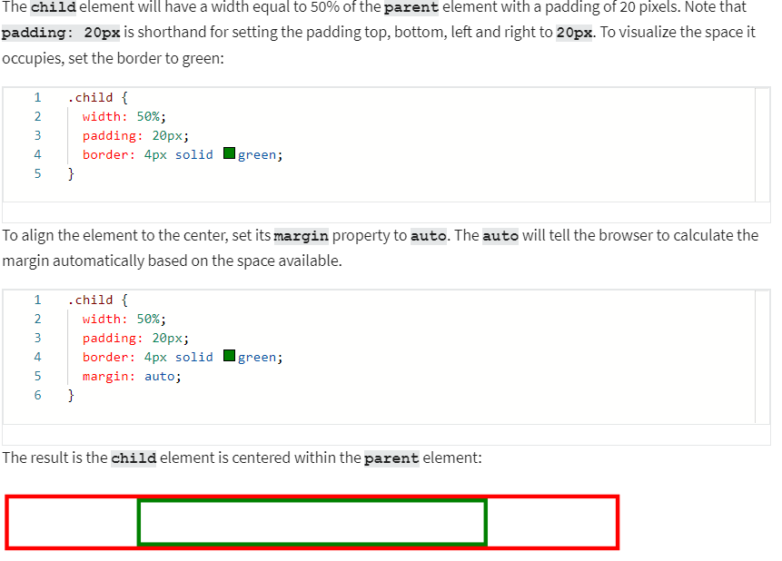
Html element center alignment
It is important to note that this works because the div element is a block-level element.

Slide 14
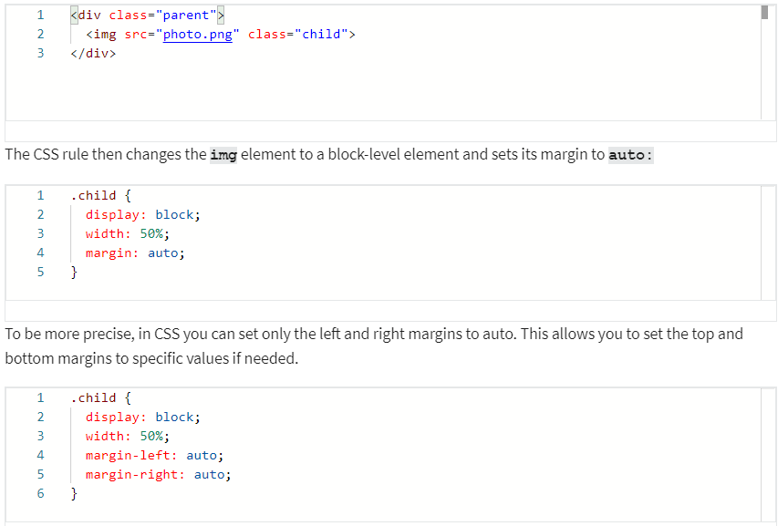
Html element center alignment
If you want to align an inline element like img, you will need to change it to a block-level element.

Slide 15
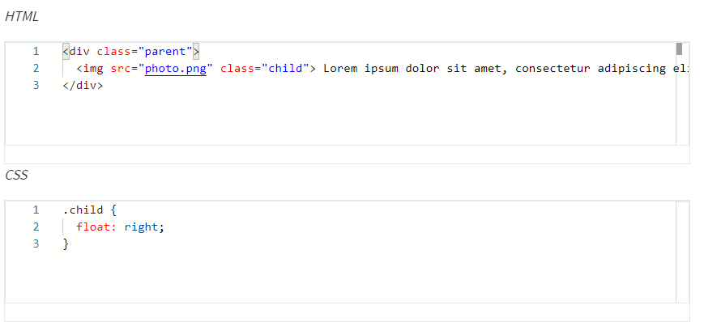
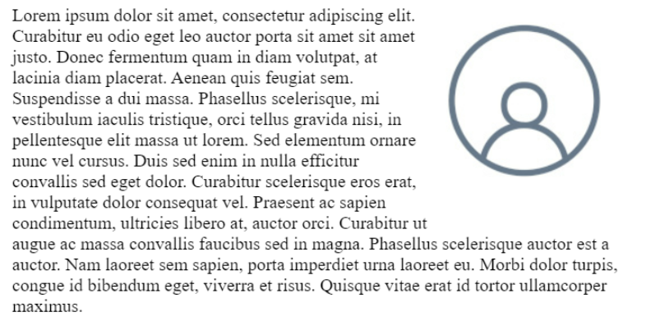
HTML Element Left / Right Alignment
The two most common ways to left and right align elements are to use the float property and the position property.

